Slide 1
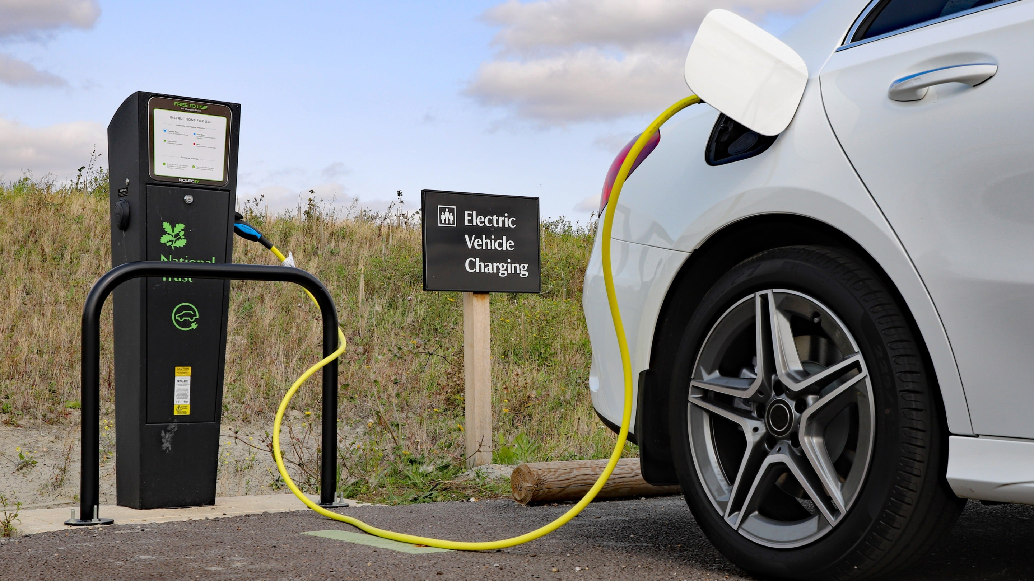
EV-Q Process Improvement Challenge
Team 3 - Wired Soldiers
Charles Beck, Grant Patterson, Lina Elkayed, Omar Hawari, Vishnu Vamsi Kapila, Will Miller, Zahra Berro
7/9/2025
Notes:
Grant + Everyone

Slide 2
We asked Canton employees…
What did you do when all EV charging spots were taken?
Notes:
Grant

Slide 3
“Nothing, if it's not available, there's not much you can do. It gets upsetting to see that some people don't follow the 4-hour rule, and some use the buddy system so they get the spot as soon as their buddy moves.”
– Yazaki Employee
“When that happens, I usually just wait and keep checking from the window to see when a spot opens up. Sometimes I end up not charging at work at all.” – Yazaki Employee
Notes:
Grant

Slide 4
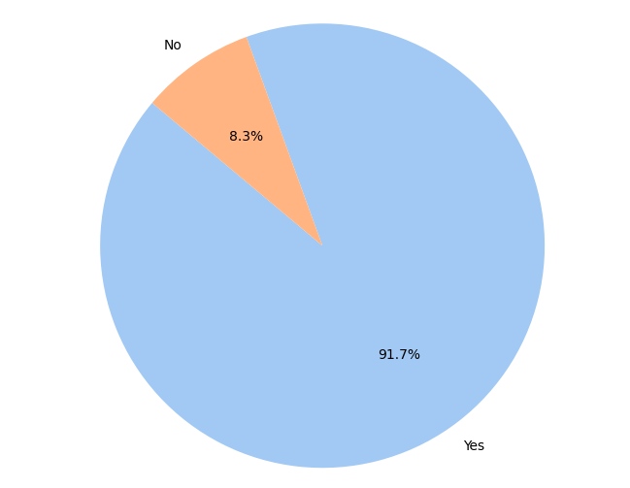
The problem in numbers
Have you ever been unable to charge your EV at work because all the spots were taken?
92% Have Been Unable to Charge
"If I don't get in before 7:30am then I struggle to get a morning charge.” – Yazaki Employee
A Manual, Inefficient System
"I just need to check whenever I am available by going back and forth from 4th floor to the parking lot.” – Yazaki Employee
Notes:
Will

Slide 5
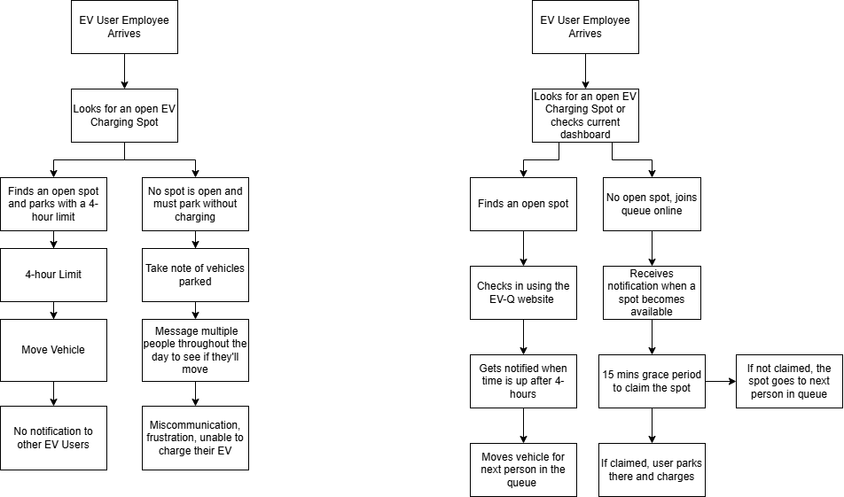
The current process is broken
This process relies on a shared email list, forcing employees to manually identify cars and contact colleagues one by one.
Notes:
Lina

Slide 6
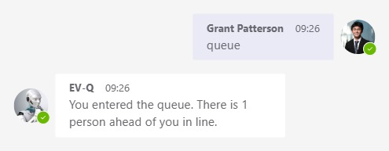
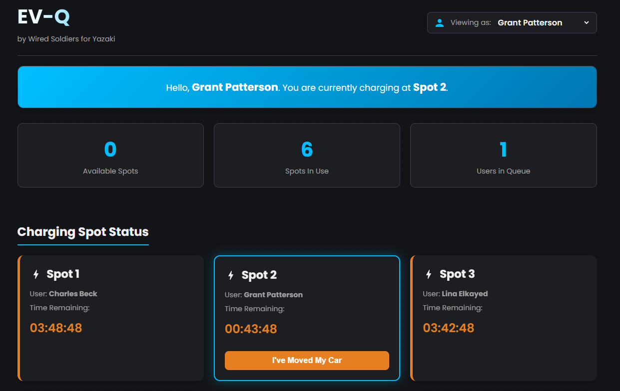
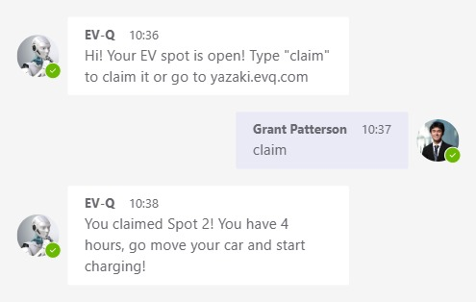
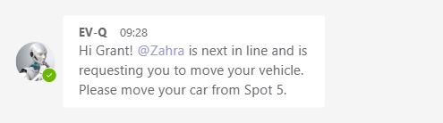
Product Introduction
Teams Integration
Website
Queue command
Claim command
Nudge
notifications
Notes:
Charlie

Slide 7
How it works: the “after”
Automated
Efficient
Simple
Equitable
Fair
Notes:
Lina

Slide 8
Deep dive: website & Teams integration
Real –time status
Automated queue
Claim & Nudge notifications
All synced together
Notes:
Charlie

Slide 9
Key features
Process improvement details:
Real-Time Visibility (Dashboard shows who is charging and for how long)
Fair & Orderly Access (Automated queue ensures first-come, first-served)
Tools, Methods, and strategies implemented
Microsoft Teams integration for communication and notification
Web application for queue management and user interaction
Automated reminders and time tracking to enforce fair usage
Enforced 4-Hour Rule (Automated reminders and a nudge button)
No More Guesswork (Notifications tell you exactly when a spot is yours)
Notes:
Omar

Slide 10
Benefits of the Improvement
Expected outcomes
Cost: Reduces need to purchase additional chargers
Time: Less time wasted checking charges availability
Quality: More organized and equitable access to chargers
Satisfaction: Improved user experience and reduced frustration among EV drivers
Short-term and long-term value
Short term: Immediate improvement in charging availability and user communication
Long term: Promotes EV adoption, supports sustainability goals, and reduces carbon footprint
Notes:
Omar

Slide 11
Who benefits?
Who Will Be Affected or Benefit from the Change?
EV- Driving Employees
Get a better experience using EV chargers with less confusion
Save time by checking charger availability online instead of walking to the lot
Fair access through a queue system — no more guessing who’s next
All Employees
Encourages Future EV Adoption:
"I've had more than one coworker decide against getting an EV because their primary charging source would be here at the office and the challenges with securing a charger dissuaded them.” – Yazaki Employee
This shows that solving this problem is crucial for Yazaki's broader sustainability goals.
Departments, Roles, or Teams Impacted:
IT Department
Assist in implementing and maintaining the system
Notes:
Zahra

Slide 12
Next steps & Implementation
Phase 1: Development & Beta Test
Develop web app and Teams bot.
Recruit 5-10 survey participants for a beta test.
Phase 2: IT Collaboration & Security Review
Work with IT to host the application and integrate with Yazaki systems.
Phase 3: Company-Wide Rollout
Onboarding sessions, user guides, and communication from HR/Facilities.
Required Support: IT Department (Implementation), Facilities (Rollout), HR (Communication).
Notes:
Vish

Slide 13
Summary and final recommendation
Canton’s EV charging can be improved for fairness, ease of use, and efficiency
Globally scalable
We propose the EV-Q, a system that standardizes waiting queues, spot claiming, and easy nudge notifications
Website
Microsoft Teams
EV-Q benefits Yazaki by:
Reducing employee time and stress of checking availability
Improving fairness
Making policies easier to enforce
Encourages sustainability through EV driving
Notes:
Vish

Slide 14
THANK YOU VERY MUCH FOR YOUR ATTENTION!
Any Questions?

